Slide 1





AIRSPACE INTELLIGENCE
Big Data Analysis of the Iberian Peninsula
Modern Data Architectures for Big Data II — Group Assignment
Group Members | March 2026
Airspace Intelligence | Big Data Architectures II | 1/11

Slide 2
PROBLEM & MOTIVATION
The Iberian Peninsula handles thousands of flights daily — how do we detect congestion and identify when an aircraft deviates from its expected corridor at scale?
01
02
03
Descriptive Analytics
Unsupervised Learning
Real-Time Classification
Who is flying over Iberian airspace and where are the busiest zones?
What are the natural air corridors being used by aircraft?
Can we classify and flag corridor deviations in real time?
Airspace Intelligence | Big Data Architectures II | 2/11

Slide 3






SYSTEM ARCHITECTURE & DATA PIPELINE
OpenSky
API
Apache
NiFi
MinIO
Bronze
PySpark
MLlib
Apache
Kafka
ADS-B data
~10s polling
Ingestion
& routing
Raw JSON
S3 storage
SQL · BKMeans
RandomForest
Streaming
inference
Lakehouse Medallion Pattern: Ingest raw → Process in Spark → Serve predictions
Airspace Intelligence | Big Data Architectures II | 3/11

Slide 4
DATA: OpenSky ADS-B & Schema
Field | Type | Description
icao24 | String | Unique aircraft transponder ID
callsign | String | Flight number / operator code
origin_country | String | Country of registration
latitude / longitude | Double | Current position
baro_altitude | Double | Barometric altitude (metres)
velocity | Double | Ground speed (m/s)
true_track | Double | Heading (degrees)
vertical_rate | Double | Climb/descent rate (m/s)
on_ground | Boolean | Is the aircraft on the ground?
Iberian Bounding Box
Lat: 36.4° — 43.2° N
Lon: −10° — 2.5° E
Processing
Spark explode() to unpack
each snapshot into rows
Filter nulls + bounding box
→ Clean base DataFrame
Airspace Intelligence | Big Data Architectures II | 4/11

Slide 5
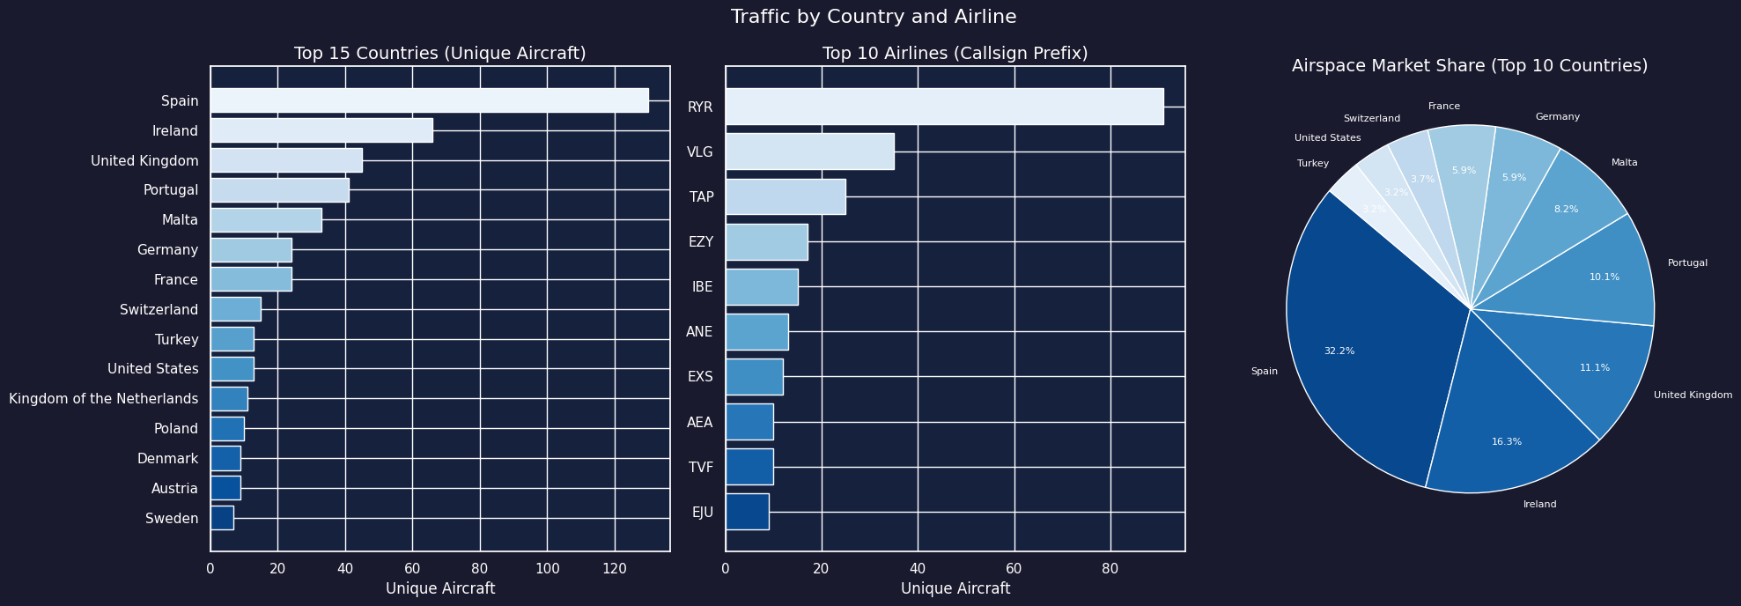
PART I — Traffic Analysis: Country & Airline
~25.6%
Spain market share
91
Ryanair unique aircraft
3rd+
UK, DE, CH transit traffic
Airspace Intelligence | Big Data Architectures II | 5/11

Slide 6

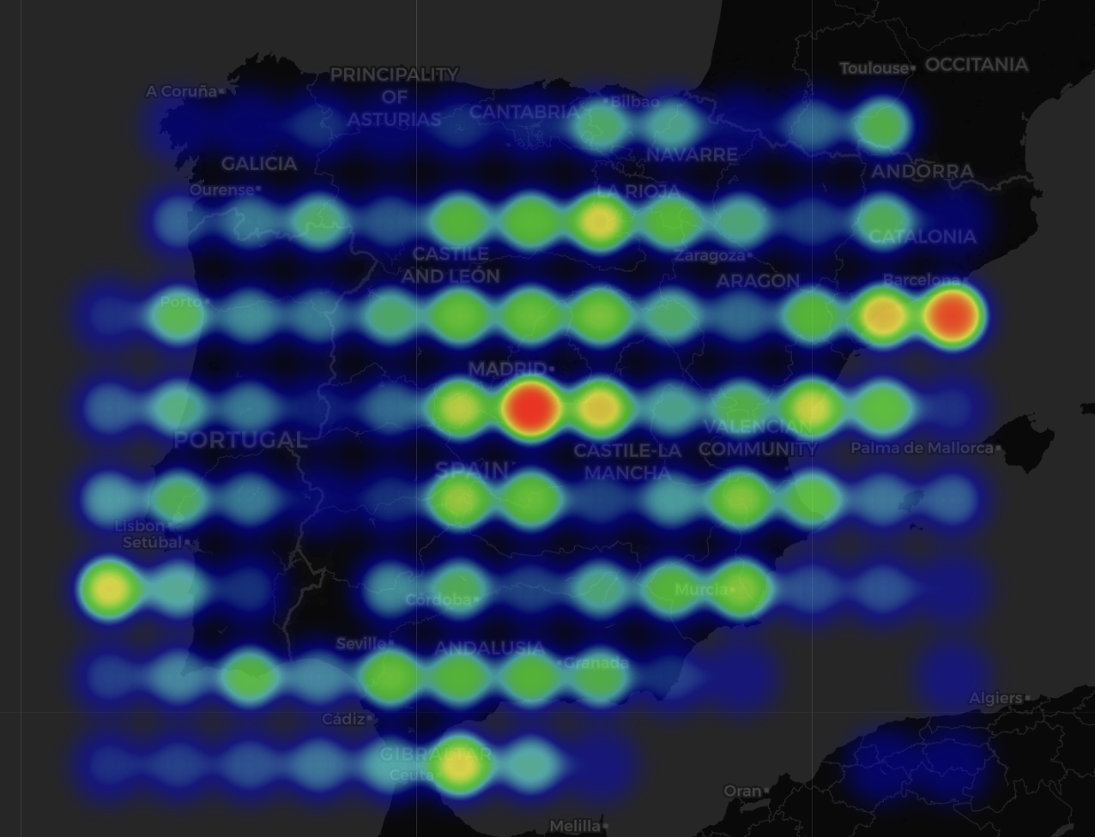
PART I — Airspace Density Heatmap
NE → SW Corridor
Main European airway to Canaries & Africa across central Spain
Catalonian Coast
High-traffic cluster near Barcelona El Prat
Portuguese Atlantic
Approach lanes to Lisbon and Porto
1° × 1° grid | Log-transformed density | Cool → Hot gradient
Airspace Intelligence | Big Data Architectures II | 6/11

Slide 7
PART II — Feature Engineering & Trajectory Resampling
1
2
3
4
Gap Detection
Flight Classification
Resampling
Feature Vector
Split each icao24 track into flight segments
(30-min gap threshold)
departure / arrival / pass_through
(hop excluded)
Interpolate to exactly 15 waypoints
(30 features per trajectory)
[lat₀, lon₀, lat₁, lon₁, … lat₁₄, lon₁₄]
Flight Type Classification Rules
Type | Rule
Departure | Start ≤ 10 km from airport, end far
Arrival | End ≤ 10 km from airport, start far
Pass-through | Neither endpoint near any airport
Hop (excluded) | Both endpoints near airports
Airspace Intelligence | Big Data Architectures II | 7/11

Slide 8


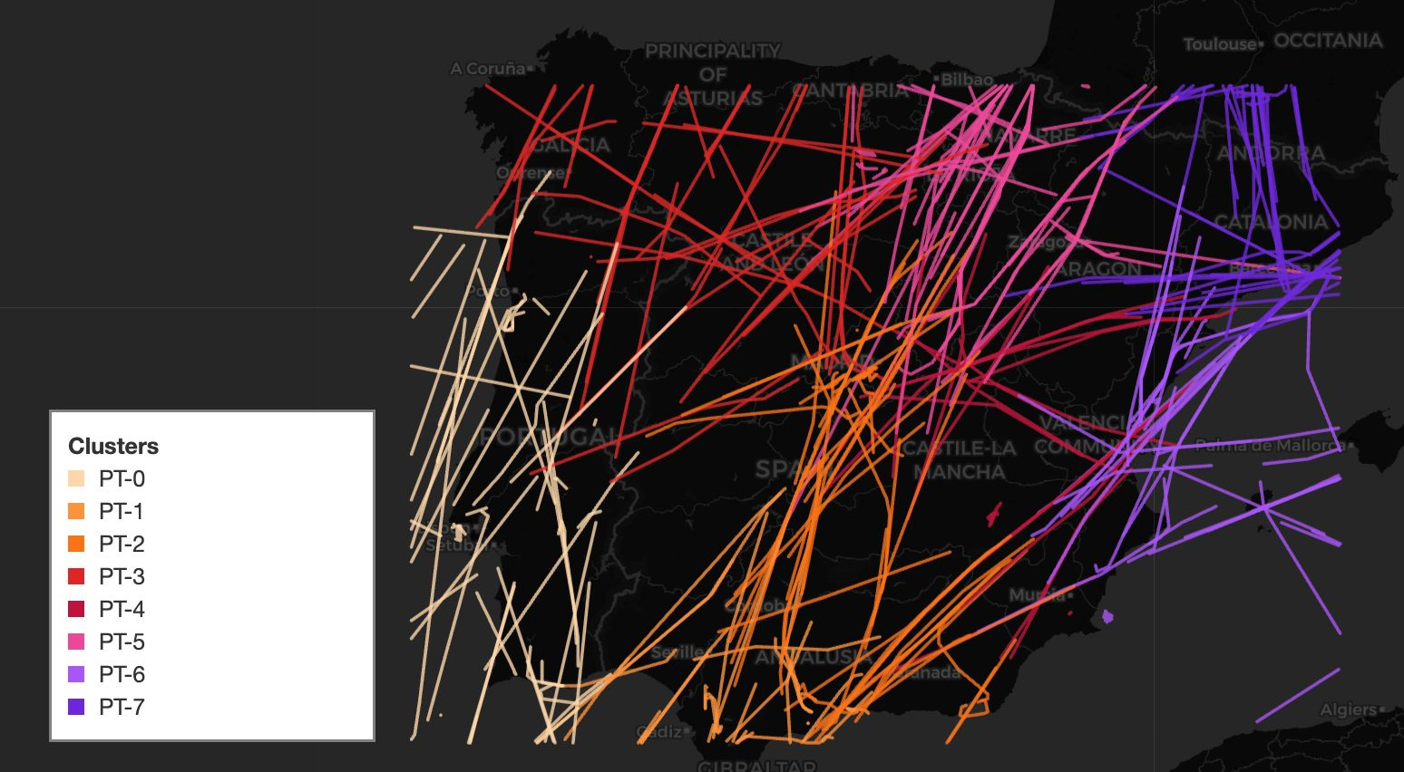
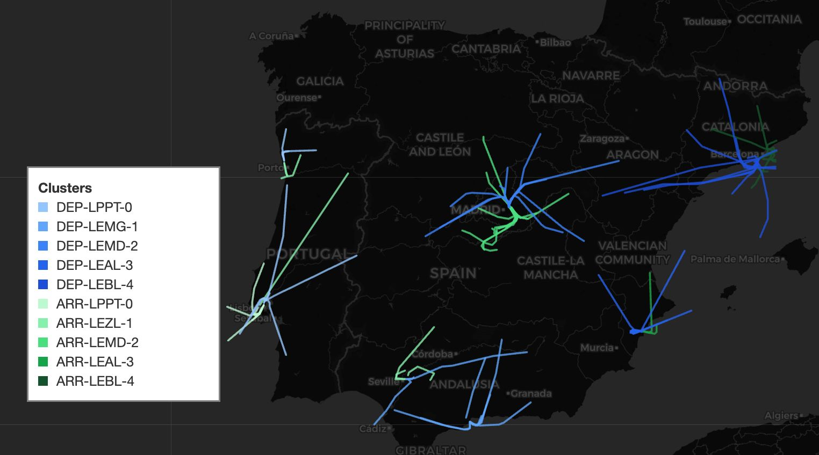
PART II — BKMeans Corridor Clustering
Pass-Through Corridors (K=8)
Arrival & Departure Corridors (K=5 each)
Algorithm: Bisecting K-Means (Spark MLlib) Eval: Silhouette Score (Sq. Euclidean) Why BKMeans: More balanced clusters, hierarchical structure
Airspace Intelligence | Big Data Architectures II | 8/11

Slide 9
PART III — Random Forest Corridor Classifier
Model Overview
Deviation Detection Logic
Algorithm: Random Forest Classifier (MLlib)
Features: lat, lon, track_sin, track_cos, vrate
Target: corridor_id (18 classes)
Split: 80/20 by flight (no leakage)
Pipeline: StringIndexer → VectorAssembler →
StandardScaler → RandomForest → IndexToString
≥ 0.70
ON CORRIDOR
0.50 – 0.70
MARGINAL
< 0.50
DEVIATING
Performance Metrics
Model Saved to MinIO
67.9%
68.9%
70.9%
68.9%
s3a://airspace-intelligence-bronze/
models/corridor_classifier/
F1 Score
Accuracy
Precision
Recall
Airspace Intelligence | Big Data Architectures II | 9/11

Slide 10
PART IV — Real-Time Streaming with Kafka
OpenSky
API
Kafka Topic
opensky_raw
Spark
Streaming
ML Model
Predict
Output
Status
1
2
3
4
New SparkSession
Load Model
readStream
Transform & Predict
Configured with Kafka + MinIO packages
PipelineModel.load() from MinIO bucket
Kafka topic opensky_raw, startingOffsets = latest
Parse JSON → explode → features → model inference → status
Output Schema
snapshot_time | icao24 | callsign | latitude | longitude | predicted_corridor | max_probability | status
Processing trigger: every 10 seconds
Airspace Intelligence | Big Data Architectures II | 10/11

Slide 11
SUMMARY & CONCLUSIONS
Stage | Technology | Output
Data Collection | NiFi + OpenSky API | Raw JSON in MinIO Bronze
Batch Processing | PySpark SQL + DataFrames | Cleaned aircraft_df
Descriptive Analysis | Spark SQL + Folium | Traffic charts + Density heatmap
Trajectory Engineering | PySpark Window + UDFs | Fixed 30-dim flight vectors
Corridor Discovery | BisectingKMeans (MLlib) | 18 labelled corridors
Corridor Classification | RandomForest (MLlib) | Trained classifier + deviation flag
Real-Time Inference | Kafka + Spark Streaming | Live status per aircraft
Key Takeaways
Spain dominates Iberian airspace (~25.6%), but transit traffic from non-Iberian carriers is substantial
BKMeans successfully discovered 18 geographically coherent corridors aligned with known airways
Random Forest enables real-time corridor classification and deviation detection at streaming scale
Thank you — Questions?
Airspace Intelligence | Big Data Architectures II | 11/11

